Slide 1
Financial Assistance Chatbot
Team Members: Bhushan, Rishabh, Sitanshu & Shohna

Slide 2
Introduction
Chatbots are developed to facilitate two-way communication, replacing channels such as phone, email or text. The objective is to provide quick service and transactional support.
Most basic tasks such as balance inquiry, bank account details, loan queries etc. can be handled by a bot efficiently, leading to a more positive banking experience. Over time, artificial intelligence (AI) and new digital technologies will provide the banking industry with expanded forms of engagement, potentially moving beyond bots to digital voice interactions.

Slide 3
Functionalities
Answer’s queries related to -
Loans.
Issuing of cheque book.
Loss of credit card.
Account details.
General finance related questions.
In case the bot is unable to answer certain
queries, the user is redirected to relevant links
or a live agent.

Slide 4
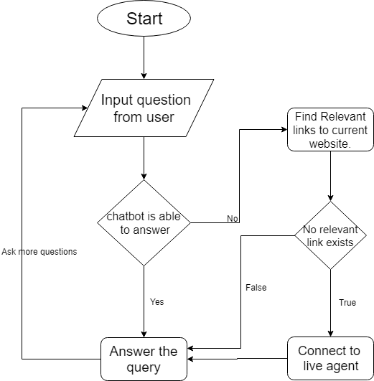
Basic Flow

